Slide 1
Research on Existing Methods
Raoul Knobbout, PCT

Slide 2
Research
3 books, methods
In this presentation: 2 books, on finding your mission in life and career counseling
According to standard framework

Slide 3
Never work again: the search for inspiration in your job
First method: “Never work again – the search for inspiration in your job”.
By Mrs. Marjan van Lier
Finding your mission in life
Suitable for broad public, vividly written
To be done with external help, for example psychologists

Slide 4
Never work again: the search for inspiration in your job

Slide 5
Never work again: the search for inspiration in your job
First part of pilgrimage: identify current wants and needs
1. Assurance: material & social
2. Individual needs: success & physical challenges
3. Social needs: collaboration, commitment & competition

Slide 6
Never work again: the search for inspiration in your job
Second part of pilgrimage: identify talents and potentials
What you can & are capable of
Identify limits & personality

Slide 7
Never work again: the search for inspiration in your job
5 TALENTS:
Nurturing
Entrepreneurial
Intellectual
Creative
Social

Slide 8
Never work again: the search for inspiration in your job
“American dream model”: do whatever you want
Instead: want whatever you can!
Design your (working) life according to your talents and potentials identified before
Doing this will ultimately result in passion for your activities: intrinsic motivation
Important for (long-lasting) passion is expertise: therefore link to talents /potentials is important

Slide 9
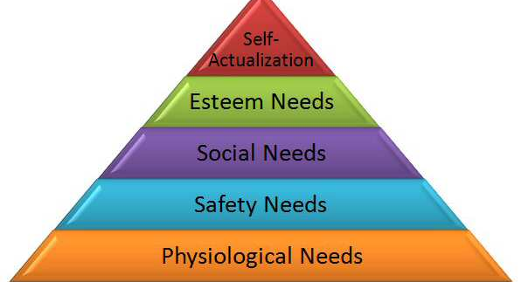
Never work again – Maslow’s Pyramid

Slide 10
2nd Book: Entrepreneurship in the course of life
Mr. Kees van Locher & Jos van der Brug
Career counseling method
“Do-it-yourself workshop”: to be completed without professional help.
Book is very specific: be your own career counselor!
Includes background reading about insights and communication techniques
Intended to be used by groups of people. Talking about and expressing problems is essential

Slide 11
Entrepreneurship in the course of life
Assumption: inner voice and ‘gut feeling’ are appropriate ‘counselors’
Most people already know what they are looking for, they only have difficulties to express it.
Therefore: creative approach

Slide 12
Entrepreneurship in the course of life
Phase 1: self-examination
What is my current situation? How do I feel about it?
What did I achieve so far? What were my successes, of which achievements am I proud?
Through creativity and storytelling about past experiences you discover your true problems in your current situation

Slide 13
Entrepreneurship in the course of life
Phase 2: what do I want to achieve?
Technique: scenario telling
Picture yourself in a working situation in three years from now, and describe in great detail what you are doing
By doing this, you will evoke emotions, telling you if you really like this situation. If not: new scenario
By repeating this, you can ‘idealize’ your scenario, which you then can use for step 3

Slide 14
Entrepreneurship in the course of life
Final phase: making an action plan and learning by doing
Take actual steps towards realizing your chosen scenario
How are you going to realize it?

Slide 15
Relevance for project 1
Clear structure found in “Entrepreneurship in the course of life”. Good instructions for trainers for every workshop:
What do you have to do?
Methodological instructions
Conversation
End

Slide 16
Relevance for project 2
In “entrepreneurship in the course of life”: all required skills are included; it is very complete
For example, after a part about giving advice: a part is included in which trainees can read about giving proper advice and how to communicate effectively
In this way, trainers always have appropriate skills

Slide 17
Relevance for project 3
From “never work again”: don’t do whatever you want.
From a famous (Dutch) motivator: “Tjakka! I can do it!” – not good
Instead: want whatever you can. Follow your talents and potentials (trees) and you will develop passion
Overall: active approach!

Slide 18
Summary
2 books, about mission in life and career development
Interesting, albeit very different methods
Both suitable as reference for project, both provide interesting methodological points

